Slide 1


MASTER OF COMPUTER APPLICATIONS | PROJECT PRESENTATION
PAGE TURN:
LIBRARY MANAGEMENT SYSTEM
A web-based application for organized library operations
Submitted by: Abhishek Biswas
Student Code: BWU/MCA/26/016
Sec: A Group:1
Department: Computational Science
Course Name: Problem Solving Using Python
Course Code: MCA17401
PROJECT
PRESENTATION
Dept. of Computational
Sciences

Slide 2
Introduction
Project Background
Project Overview
Libraries manage books, student records and issue–return activities. Manual record-keeping becomes time-consuming as collections and users grow.
PAGE TURN is a web-based Library Management System that digitizes routine library operations through a simple browser-based interface.
Core areas covered
BOOKS
STUDENTS
ISSUE / RETURN
DASHBOARD
Add, search and delete records
Register and manage student details
Track borrowing and returns
View collection and availability statistics
PAGE TURN | LIBRARY MANAGEMENT SYSTEM
02

Slide 3
Problem Statement
Manual library administration can create operational difficulties:
Record maintenance
Maintaining book and student registers requires repeated manual updates.
Book discovery
Finding a book and confirming its availability can take time.
Record accuracy
Duplicate or incorrect entries may affect the reliability of records.
Issue tracking
Tracking borrowed books and return status can be difficult.
Fine calculation
Manual calculation of late-return fines may lead to errors.
PAGE TURN | LIBRARY MANAGEMENT SYSTEM
03

Slide 4
Project Objectives
Primary Objective
Secondary Objectives
Develop a web-based Library Management System that simplifies routine library operations and reduces manual work.
Expected outcome:
A centralized application for managing books, students, issue–return activities and library information.
• Maintain book and student records digitally.
• Provide book search and filtering facilities.
• Manage book issuing and returning.
• Update book availability automatically.
• Calculate fines for late returns.
• Prevent deletion of records involved in active issues.
• Display library statistics on a dashboard.
PAGE TURN | LIBRARY MANAGEMENT SYSTEM
04

Slide 5
Scope of the Project
Coverage
Target Users
Book management • Student registration • Issue and return processing • Search and filter • Fine calculation • Dashboard statistics
Small-scale libraries and library staff who need to maintain book records, student details and borrowing information.
Current limitations
• No user authentication or role management.
• No barcode scanning, online reservations or automatic notifications.
• JSON file storage; intended mainly for small-scale library operations.
PAGE TURN | LIBRARY MANAGEMENT SYSTEM
05

Slide 6
Literature Review / Existing System
Existing Approach
Identified Limitations
Traditional library operations commonly rely on manual registers or basic record-keeping methods.
Staff record book details, student information, issue dates and returns manually.
• Time-consuming searching and record updates
• Difficulty tracking current book availability
• Possibility of duplicate or incorrect entries
• Manual issue tracking and fine calculation
The report does not cite a separate comparative research study; this review reflects the existing approach described in the report.
Project response: digitize the core workflows in one web-based application.
PAGE TURN | LIBRARY MANAGEMENT SYSTEM
06

Slide 7
Proposed System
A centralized web application for managing the essential activities of a small-scale library.
Book Management
Student Management
Add, search and delete book records; prevent duplicate Book IDs.
Register students and maintain student details.
Book Issue
Book Return
Issue available books only to registered students.
Update availability and calculate late-return fines.
Search & Filter
Dashboard
Find books by ID, title, author, category and availability.
Display total, available and issued books, students and charts.
PAGE TURN | LIBRARY MANAGEMENT SYSTEM
07

Slide 8
Project Methodology & Technology Stack
Development approach: Incremental development
Requirement
Collection
→
Analysis
→
System
Design
→
Implementation
→
Testing
→
Documentation
Technologies and tools
Backend
Python, Flask
Frontend
HTML, CSS, JavaScript
Data storage
JSON files (Books.json, Students.json)
Charts
Chart.js
Development environment
Windows, Visual Studio Code, web browser
PAGE TURN | LIBRARY MANAGEMENT SYSTEM
08

Slide 9
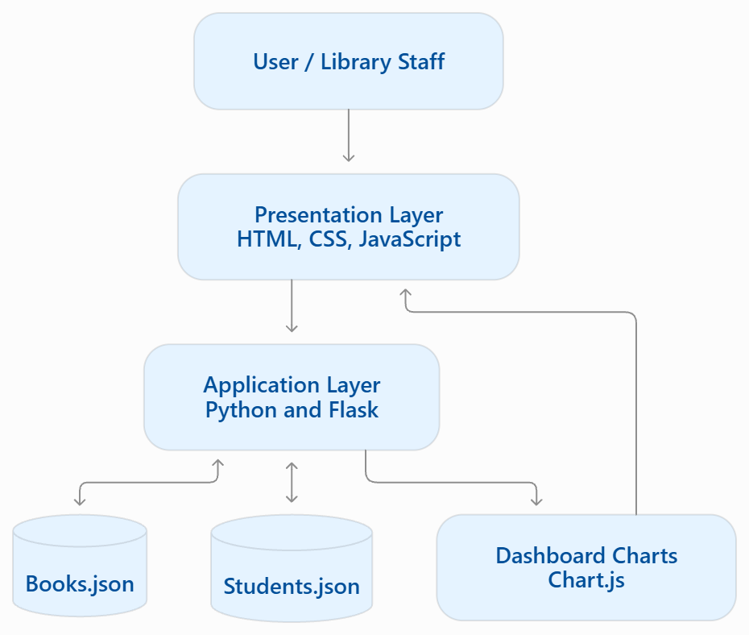
Project Internal Structure
Three-layer system architecture
Presentation Layer
HTML, CSS and JavaScript interface.
Application Layer
Python and Flask handle requests and business logic.
Data Layer
JSON files store book and student records.
Chart.js supports graphical statistics on the dashboard.
PAGE TURN | LIBRARY MANAGEMENT SYSTEM
09

Slide 10
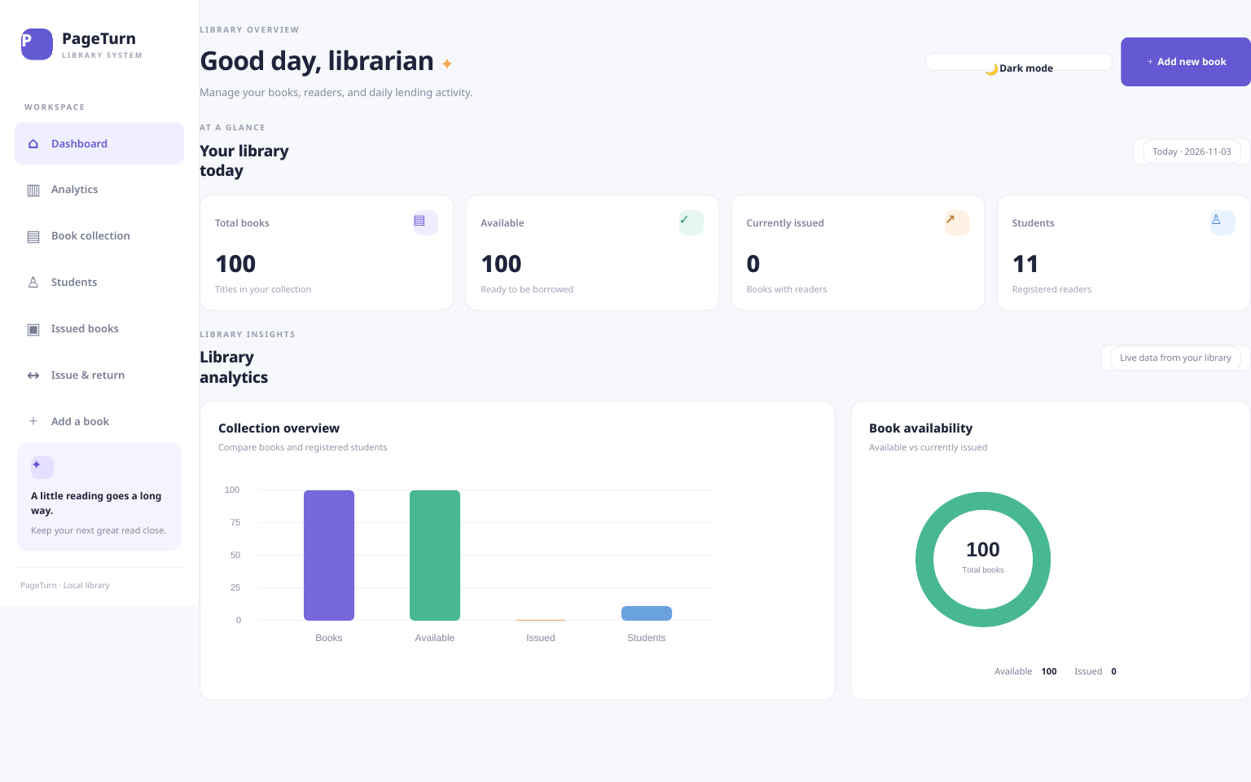
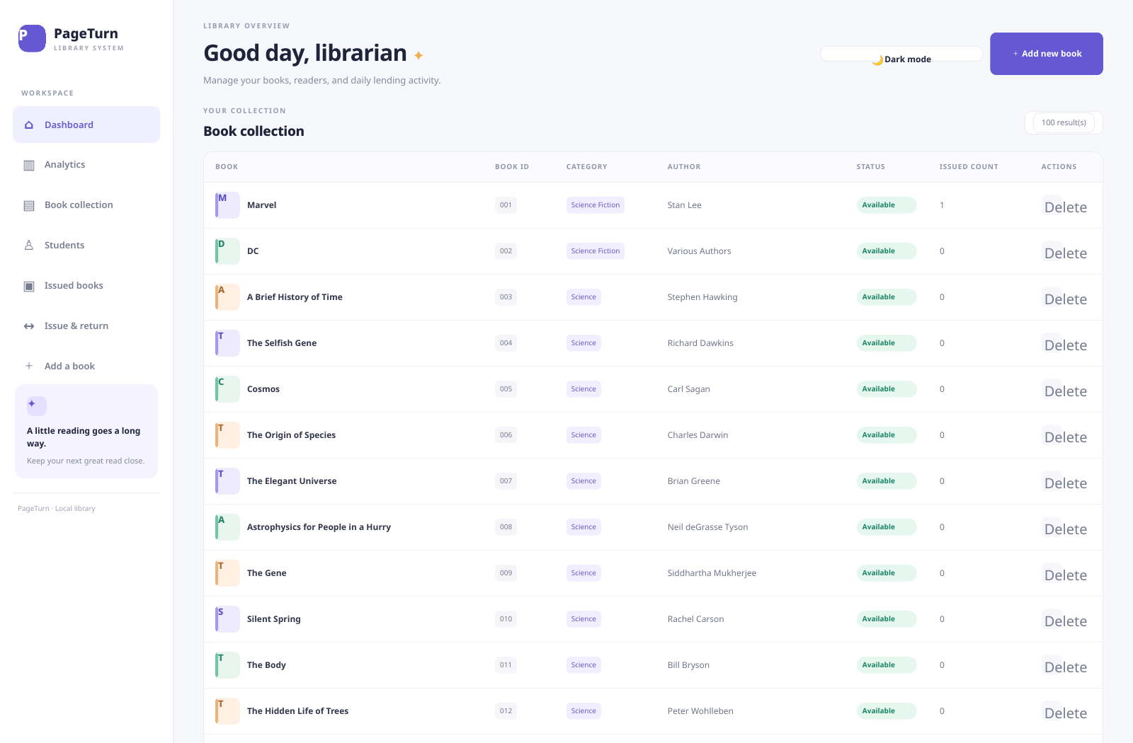
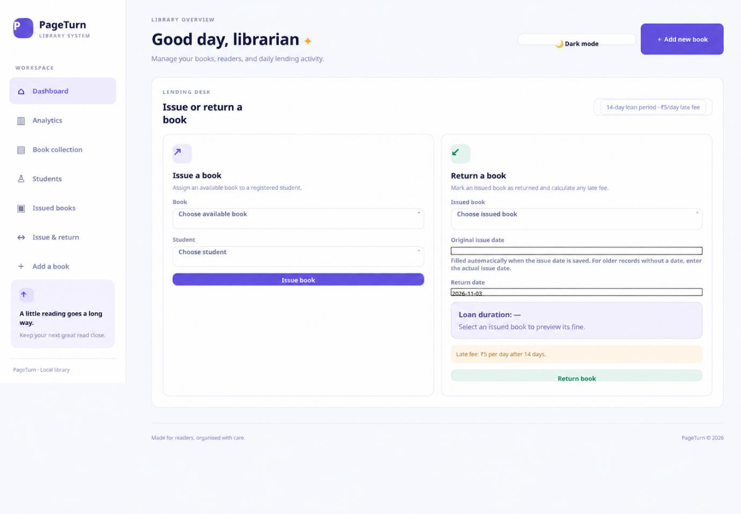
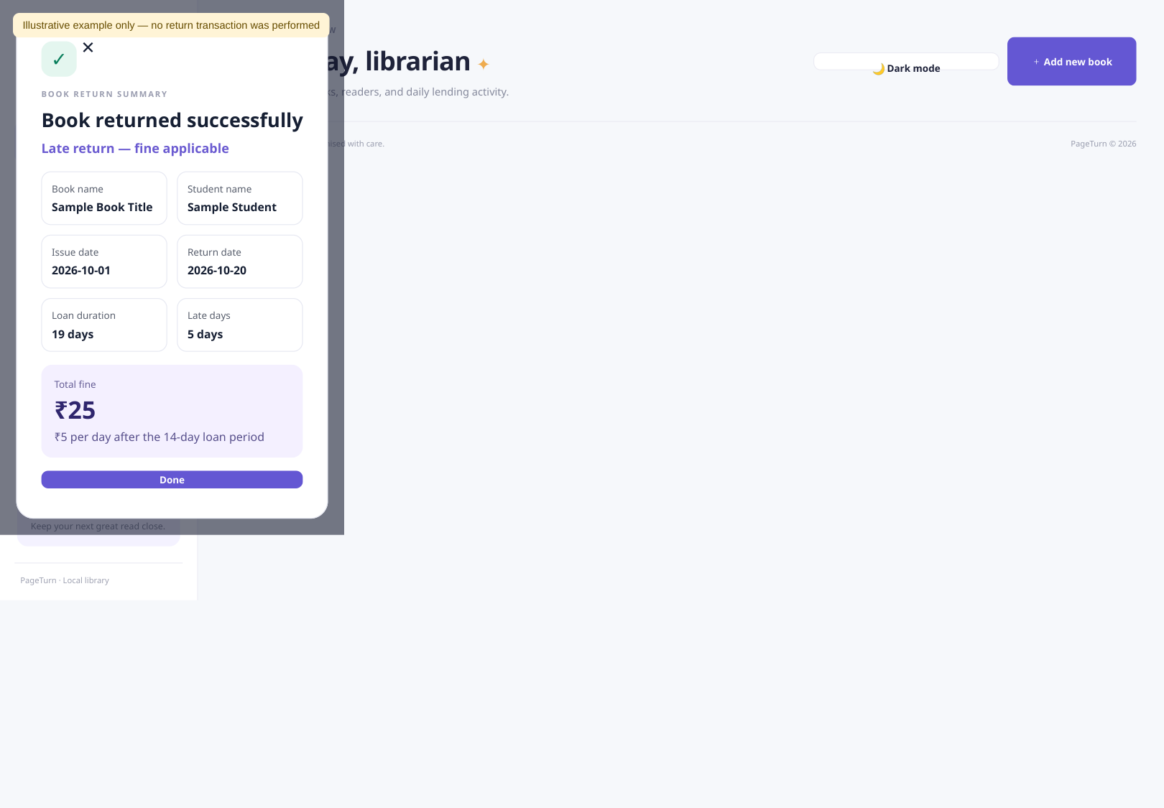
Implementation: Major Modules
Dashboard
Book Management
Book Issue
Book Return & Fine
PAGE TURN | LIBRARY MANAGEMENT SYSTEM
10

Slide 11
Testing and Results
Test cases and expected behaviour recorded in the project report
TEST CASE | EXPECTED RESULT
Add valid book / student | Record added successfully
Duplicate ID | Entry rejected
Issue available book | Book issued successfully
Issue unavailable book | Operation rejected
Return book | Availability updated
Late return | Fine calculated correctly
Search book | Matching records displayed
Delete active record | Deletion restricted
Observed: common operations run efficiently; validation and automatic status updates support record accuracy.
PAGE TURN | LIBRARY MANAGEMENT SYSTEM
11

Slide 12
Conclusion
PAGE TURN successfully demonstrates a simple web-based solution for essential library operations.
• Digitizes book and student record management.
• Supports book issuing, returning, searching and filtering.
• Calculates late fines at ₹5 per additional day after the 14-day loan period.
• Protects active issue records from accidental deletion.
• Provides dashboard statistics and graphical summaries.
Overall Outcome
The project addresses its primary objective by reducing paperwork, saving time and improving the organization of small-scale library operations.
PAGE TURN | LIBRARY MANAGEMENT SYSTEM
12

Slide 13
Future Scope
Database Integration
Secure Access
Use MySQL or MongoDB instead of JSON files.
Introduce login authentication and user roles.
Borrowing History
Barcode / QR
Maintain complete issue–return history.
Support faster book identification and circulation.
Notifications
Extended Access
Add email and SMS reminders.
Enable report export, cloud access and multiple branches.
These enhancements can improve security, scalability and operational efficiency.
PAGE TURN | LIBRARY MANAGEMENT SYSTEM
13

Slide 14
References
Python Software Foundation
MDN Web Docs
Python Documentation
https://docs.python.org/3/
JavaScript Documentation
https://developer.mozilla.org/en-US/docs/Web/JavaScript
Pallets Projects
JSON
Flask Documentation
https://flask.palletsprojects.com/
Introducing JSON
https://www.json.org/
MDN Web Docs
Chart.js
HTML Documentation
https://developer.mozilla.org/en-US/docs/Web/HTML
Chart.js Documentation
https://www.chartjs.org/docs/
MDN Web Docs
W3C
CSS Documentation
https://developer.mozilla.org/en-US/docs/Web/CSS
Web Standards and Technical Resources
https://www.w3.org/
References reproduced from the submitted project report.
PAGE TURN | LIBRARY MANAGEMENT SYSTEM
14

Slide 15
THANK YOU!
Dept. of Computational
Sciences

